Slide 1

Cost Control Components
IPA 2026
Josiah Spilker

Slide 2
Table of Contents
Overview
Process
Implementation
Testing
Results
Demo
Review

Slide 3
Overview
Initial Situation
Goal
Manual Budget & Expense Creation
Lack of Clarity & Overview
No Tracking
Record Budgets & Expenses through forms
visual indicators
Automatic budget monitoring

Slide 4
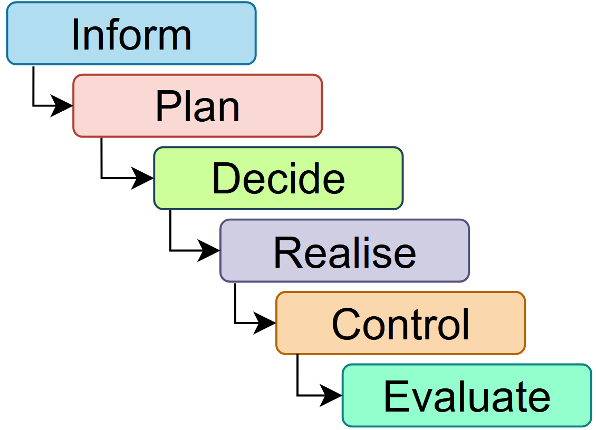
Process
IPERKA
Use of IPERKA throughout
Required by specifications
Waterfall approach

Slide 5
Timeline

Slide 6
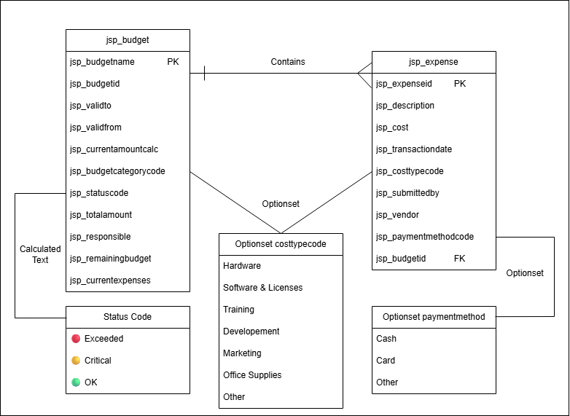
Implementation
Structure
Dataverse
Optionsets
Calculated Fields

Slide 7
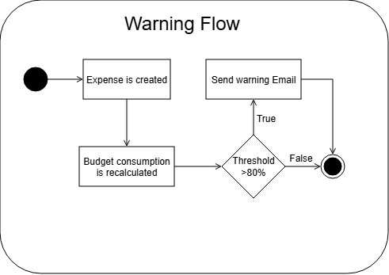
Implementation
Structure
Warning notification
Deactivation
Weekly Report

Slide 8
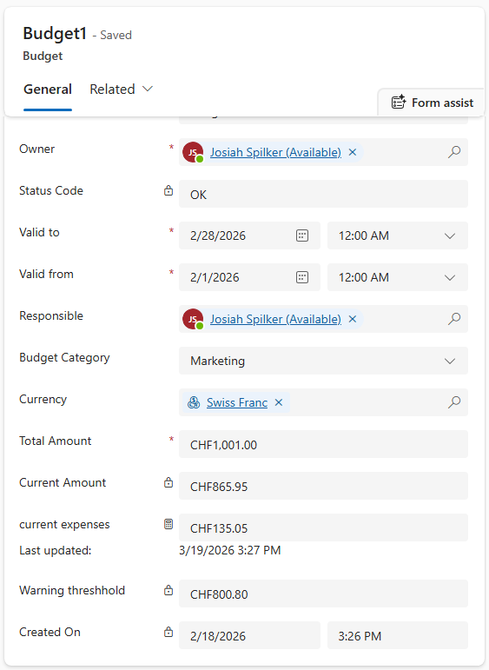
Implementation
Calculated fields
Current Amount
Total Amount -current Expenses
Current Expenses
Sum of all related Expenses
Warning Threshhold
80% of Total Amount

Slide 9
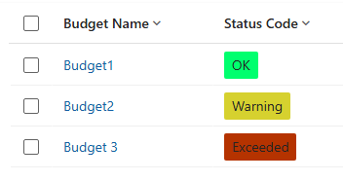
Implementation
Visual Clarity
Traffic Light system
Calculated Optionset
Non Modern Function

Slide 10
Testing
Test-driven development
19 total tests
2 failures
Limit Testing

Slide 11
Testing
Test-driven development
19 total tests
2 failures
Limit Testing

Slide 12
Testing
Test-driven development
19 total tests
2 failures
Limit Testing

Slide 13
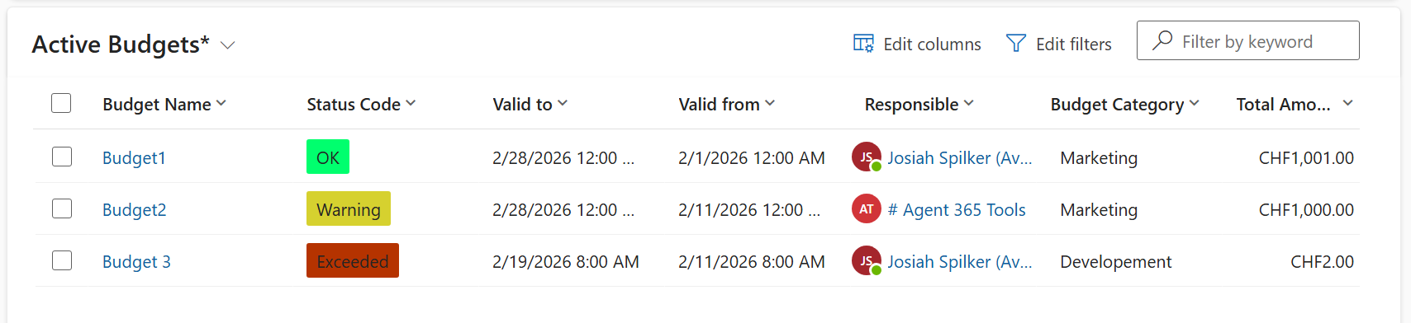
Result
Budgets:

Slide 14
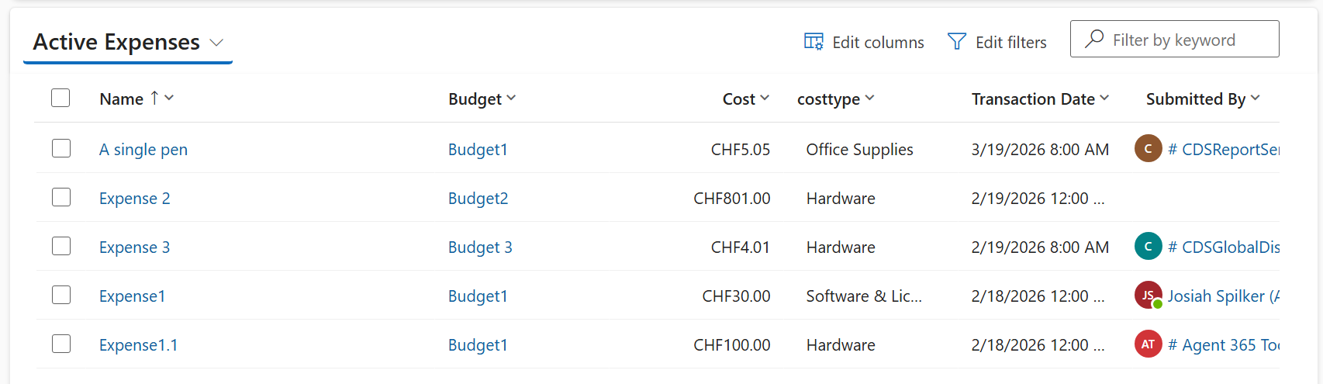
Result
Expenses:

Slide 15
Demo

Slide 16

Review
Overall Success
Completed + Optional
Ahead of schedule
Planning Lessons
Task durations
IPERKA vs. Reality
Strict < Fluid
Linear < Iterative
Transparency

Slide 17

Future enhancements
Business Logic
multi-currency
Notification Refinements
Prevent notification spam
expense approval
Deployment changes
Remove hardcoded URI
Security & Workflows
Role-Based Access
expense approval

